Slide 1
Project Presentation of Back End Engineering Project (BEE) (22CS026)
On
<Real-Time Chat App>
<Saikat Hazra>
<2210992216>
Supervised By
<Harpreet Kaur/Saikat Hazra/Sachidananad Gupta>
Department of Computer Science and Engineering,
Chitkara University, Punjab

Slide 2
Submitted By:
Saikat Hazra (2210992216)
Sachidananad Gupta (2210992202)
Sachin Kumar (2210992204)
Sarbraj Singh (2210992258)
Ishanesh Srivastava (2210991685)
5th semester, Session: 2022-2026

Slide 3
Introduction
Objective
To develop a scalable and secure real-time messaging platform enabling instant communication with features like text, media sharing, file uploads, notifications, and video/voice calls.
Introduction to MERN Stack
In this presentation, we will explore the MERN stack for building a scalable and secure real-time chat application. The MERN stack consists of MongoDB, Express.js, React, and Node.js, allowing for efficient development of modern web applications with instant messaging and media sharing features.
3

Slide 4
Key Features of the Application
Our chat application will focus on essential features such as instant messaging, media sharing, and integrated communications. These features enhance user engagement and ensure a seamless experience. Additionally, we will implement user authentication and data encryption for enhanced security.
To develop the application, we need to set up the MERN environment. This includes installing Node.js, configuring MongoDB, and setting up Express.js for backend services. Proper configuration ensures a smooth development process and allows for effective communication between front-end and back-end components.

Slide 5
Building Real-Time Functionality
Implementing real-time functionality is crucial for a chat application. We will use Socket.io to enable real-time communication between users. This allows for instant message delivery and updates, creating an engaging user experience. Proper handling of events and connections is essential for performance.
1. Full MERN Stack Development:
- Pros: High customization and scalability
- Cons: Time-intensive and complex
2. Pre-built Frameworks (e.g., Firebase):
- Pros: Quick setup, cost-effective
- Cons: Limited customization and scalability
3. Hybrid Approach:
- Combines custom backend and third-party services

Slide 6
Advantages & Disadvantages
Advantages:
Instant Communication: Facilitates real-time messaging, reducing communication delays and enhancing user experience.
Scalability: The system can scale to accommodate a growing number of users without significant performance degradation.
Cross-Platform Access: Supports multiple platforms (web and mobile), ensuring accessibility for all users.
Integration Capabilities: Easily integrates with other tools and platforms (e.g., file storage, video conferencing).
Disadvantages:
1.High development complexity: Building a fully functional real-time application with features like push notifications, media sharing, and video calls can be complex.
2.Resource-Intensive:Requires significant time, skill, and resources for both backend and frontend development.

Slide 7
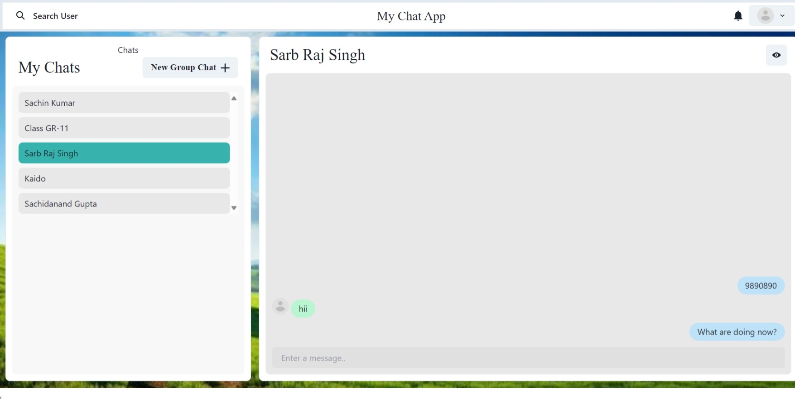
Project Highlights

Slide 8
Conclusion
In conclusion, building a scalable and secure real-time chat application using the MERN stack is achievable with proper planning and implementation. Future work may include adding features such as video calls and group chats, enhancing user experience and engagement further.

Slide 9
Thank You
9

